Slide 1
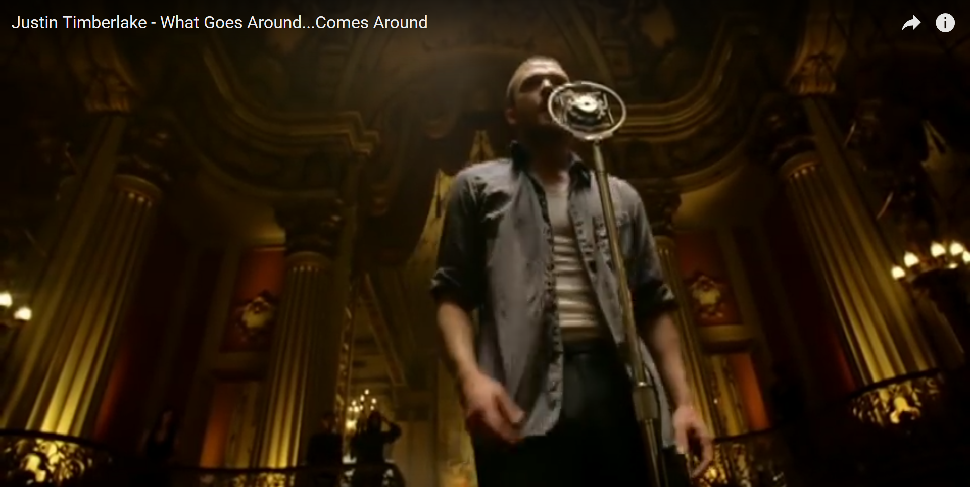
The beat goes on …
Weekly demo
Arnold BARNA
2017-11-10

Slide 2



Introduction – Arnold BARNA
Electrical engineer since 2000 (also with E.ON)
Hobby programmer for years
.NET, SQL, Perl, etc
English (C1)
German (B2)
Seasoned project manager
Loading … 53%
(Week #9 of 17)

Slide 3
Problem domain
Queryable song catalog
Gamora & Starlord's Awesome Green Fox Mix ☺
Song entities has the following properties
Author
Title
Genre
Year
Rating
Tasks
Back-end server
ASP.NET Core
Persistence
SQL database in the background
CRUD (Create, Read, Update, Delete)
API (REST)
JSON data interchange
QA
Integration testing with xUnit
Simple front-end
BootStrap

Slide 4
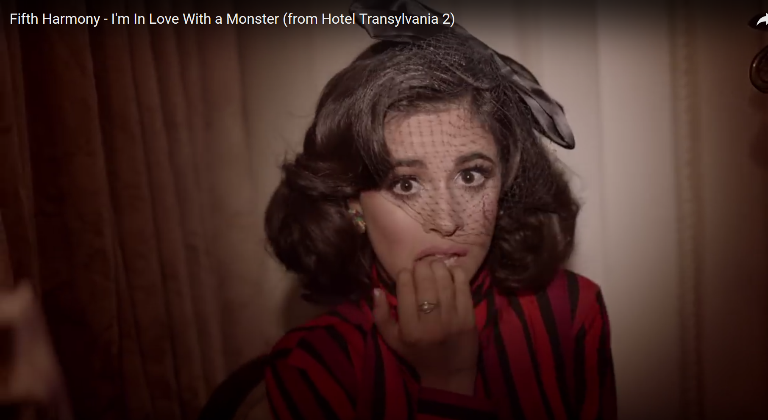
How I felt (scared) …

Slide 5
Controller endpoints 2/1
Path | Method (HTML) | Method (API) | Function
/show | GET | GET | Shows all songs but deleted ones
/show/{id} | GET | GET | Shows one song (if not deleted)
/add | GET | - | Displays the form for adding a new song
/add | POST | POST | Saves, then displays the confirmation of update if succeeded (displays form once again if not)
/update/{id} | GET | - | Displays the form for updating an existing song
/update | POST | PATCH | Updates, then displays the confirmation of update if succeeded (displays form once again if not)
/delete/{id} | GET | DELETE | Deletes, then displays the confirmation of deletion if succeeded (displays error message if not)

Slide 6
Controller endpoints 2/2
Path | Returns the list of …
/list/authors | … authors
/list/years | … years
/list/genres | … genres
/list/author/{author} | … songs from the same author
/list/year/{year} | … songs from the same year
/list/genre/{genre} | … songs of the same genre

Slide 7
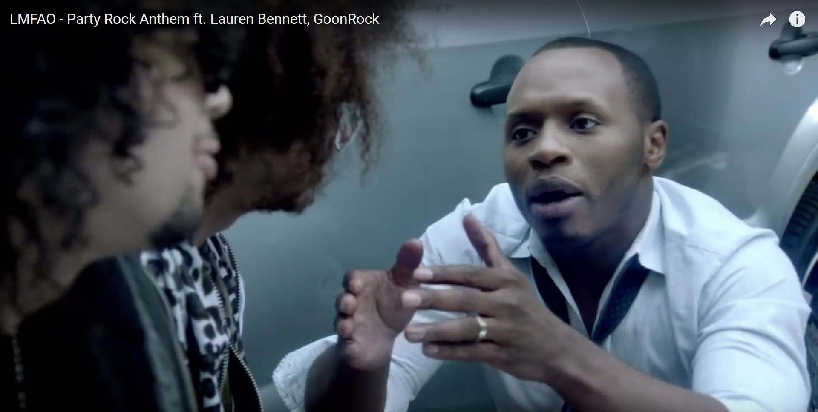
Mentors explaining …

Slide 8
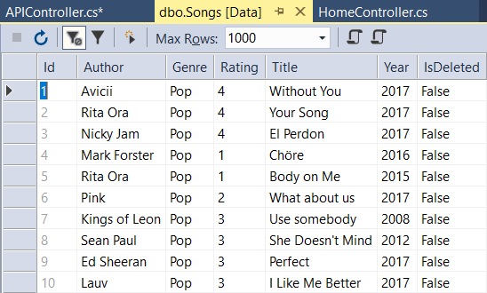
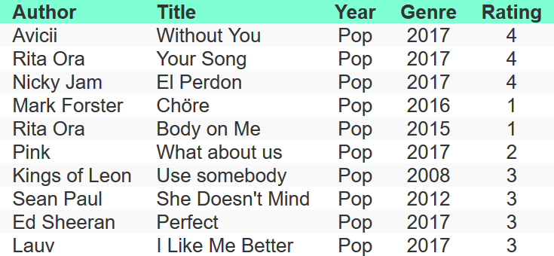
Persistence
IN VISUAL STUDIO
HTML w/ Bootstrap

Slide 9
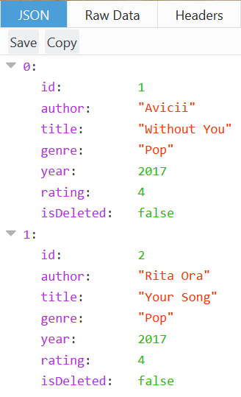
Persistence
IN VISUAL STUDIO
Json result

Slide 10
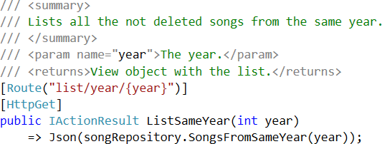
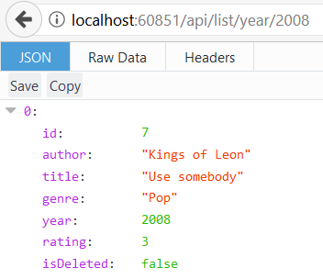
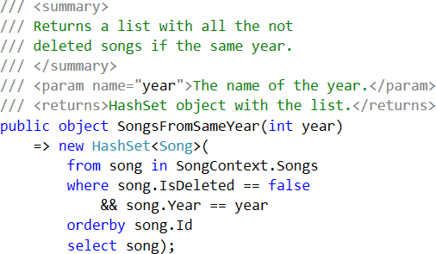
Filtering
API COntroller
Repository
Result in json

Slide 11
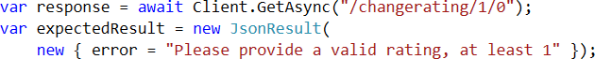
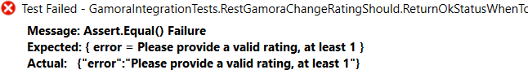
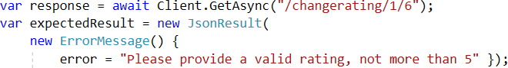
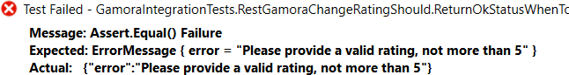
QA: Integration tests

Slide 12
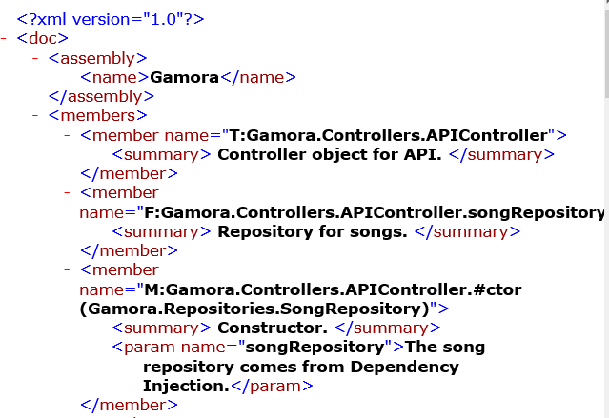
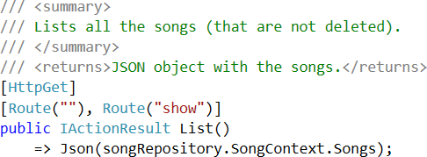
QA: Auto-generated documentation

Slide 13
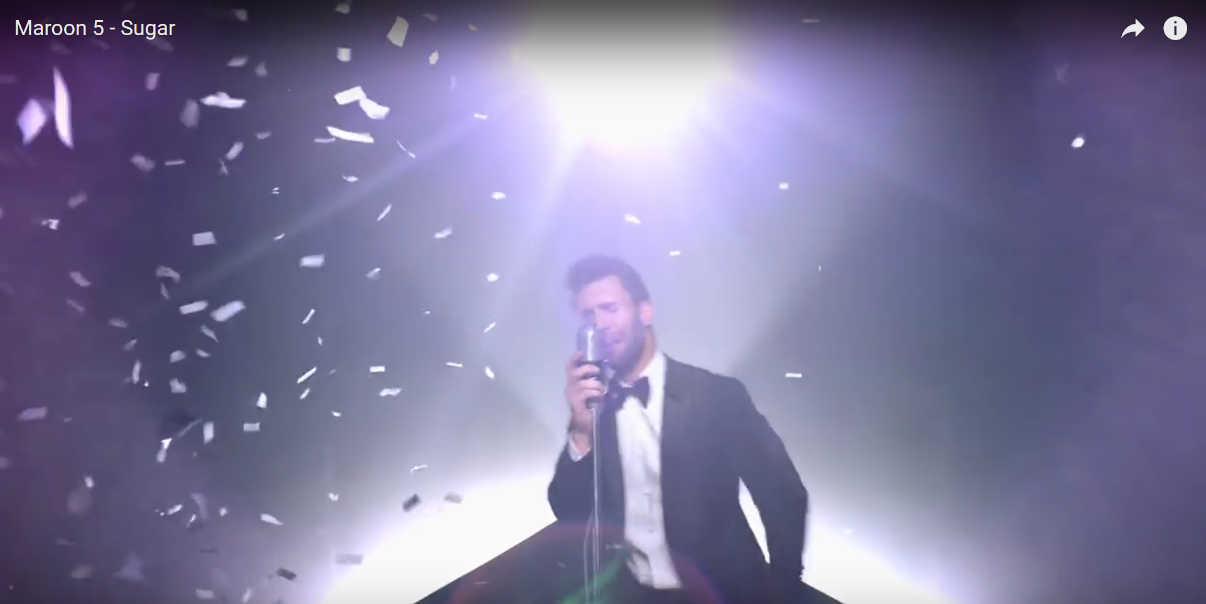
How I feel now (like a hero) …

Slide 14
Thank you for the attention
Available on GitHub:
Code:
https://github.com/greenfox-academy/bramble100/tree/master/week-09/
Slides:
https://github.com/greenfox-academy/bramble100/tree/master/week-09/demo

